Slide 1
Object Oriented Design & Programming
Unit-1 Introduction OODP

Slide 2
🞄 Programming languages allow programmers to code software.
Programming Languages
🞄 The three major families of languages are:
Machine language
Assembly language
High-Level languages

Slide 3
🞄 Machine language is the language which a CPU understands
🞄 It consists only of numbers: 0 & 1.
🞄 Example of code:
🞄 1110100010101 111010101110
🞄 10111010110100 10100011110111
🞄 Any computer can directly understand only its own machine
language, defined by its hardware design.
🞄 Machine dependent
🞄 Difficult to program –one misplaced 1 or 0 will cause the
program to fail.
Machine Language

Slide 4
🞄 Similar to machine language, but use naturally understandable symbols called “Mnemonics” for numeric instructions present in the machine language.
🞄 Assembly languages are a step towards easier programming.
🞄 Example:
🞄 Load 5, Load 1, Add
🞄 ADD 1001010, 1011010
🞄 It works directly with microprocessor
🞄 Assembly language code needs to be translated to machine
language before the computer processes it.
🞄 Assembly language is intermediate between high level language
and machine code.
Assembly Language

Slide 5
programming.
🞄 High-level languages represent a giant leap towards easier
🞄 The syntax of HL languages is similar to English.
🞄 Historically, we divide HL languages into two groups:
High level Language
1. Procedural languages
🞄 Ex. C language
2. Object-Oriented languages (OOP)
🞄 Ex. C++, Java, C#

Slide 6
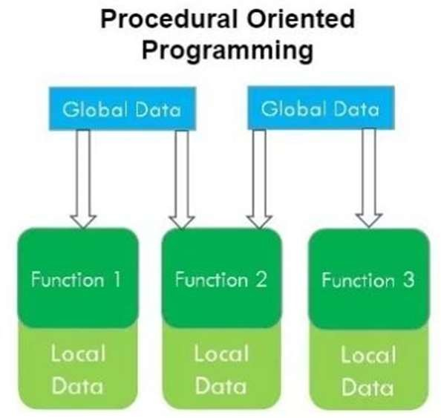
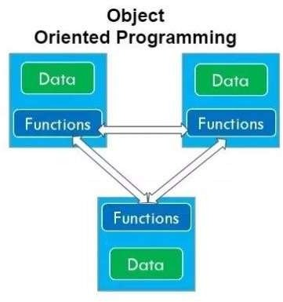
POP vs. OOP

Slide 7
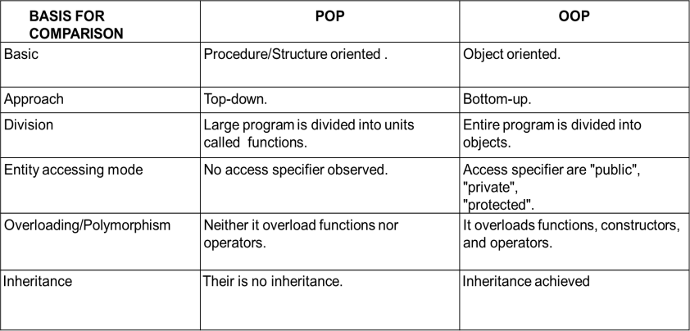
Difference

Slide 8
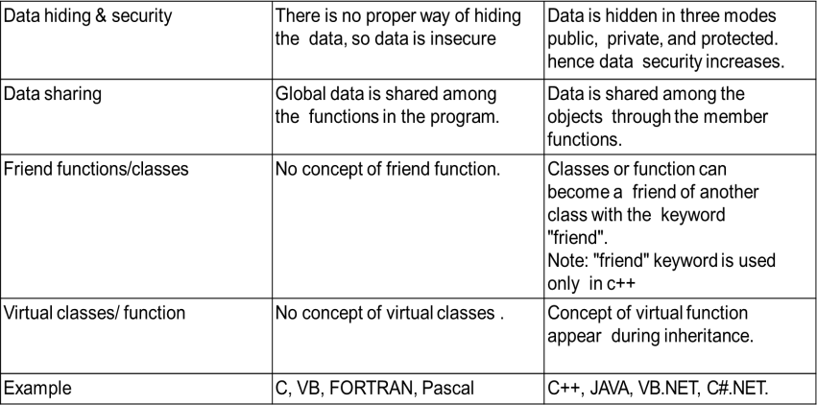
Difference

Slide 9

POP
OOP
Void main( )
{
char company_nm[20]; char model_nm[20]; char fuel_type[10]; float mileage;
double price;
//other code operation
}
Class Car
char company_nm[20]; char model_nm[20]; char fuel_type[10]; float mileage;
double price;
//other code operation
Example
Company Name: Hyundai Model Name: Elite i20 Fuel Type: Petrol / Diesel Mileage: 12 km/ltr
Price: 8 lac
Void main( )
{
Car Object1; Car Object2;
}

Slide 10
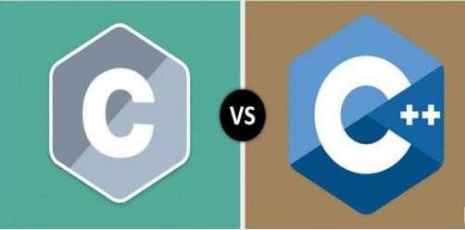
Difference

Slide 11
Difference between C and C++
 | C | C++
1 | C is Procedural Language. | C++ is non Procedural i.e Object oriented Language.
2 | No virtual Functions are present in C. | The concept of virtual Functions are used in C++.
3 | In C, Polymorphism is not possible. | The concept of polymorphism is used in C++.
4 | Operator overloading is not possible in C. | Operator overloading is one of the greatest Feature of C++.
5 | Top down approach is used in Program Design. | Bottom up approach adopted in Program Design.
6 | No namespace Feature is present in C Language. | Namespace Feature is present in C++ for avoiding Name collision.
7 | In C, scanf() Function used for Input. printf() Function used for output. | In C++ Cin>> Function used for Input. Cout<< Function used for output.

Slide 12
Difference between C and C++
 | C | C++
8 | Mapping between Data and Function is difficult and complicated. | Mapping between Data and Function can be used using "Objects".
9 | C requires all the variables to be defined at the starting of a scope. | C++ allows the declaration of variable anywhere in the scope i.e at time of its First use.
10 | No inheritance is possible in C. | Inheritance is possible in C++.
11 | In C, malloc() and calloc() functions are used for Memory Allocation and free() function for memory Deallocating. | In C++, new and delete operators are used for Memory Allocating and Deallocating.
12 | It supports built-in and primitive data types. | It support both built-in and user define data types.
13 | In C, Exception Handling is not present. | In C++, Exception Handling is done with Try and Catch block

Slide 13
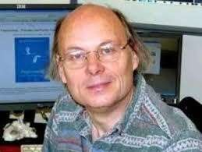
🞄 It stands for Object Oriented Programming.
🞄 Founder of C++:
Bjarne Stroustrup (1979)
🞄 The focus of OOP languages is not on structure, but on modeling
data.
🞄 Programmers code using “blueprints” of data models called
classes.
🞄 OOP encourages developers to decompose a problem into its
constituent parts.
🞄 Complexity is reduced and the programmer can manage larger
programs.
🞄 Save development time (and cost) by reusing code.
🞄 Easier debugging
Introduction to OOP

Slide 14
Class
Object
Abstraction
Encapsulation
Inheritance
Polymorphism
Dynamic binding
Message Passing
Object Oriented Concept

Slide 15


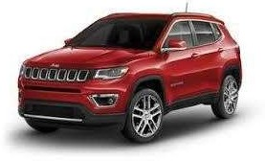
🞄 It is a user-defined data type, which holds its own data members and member functions, which can be accessed and used by creating an instance of that class.
🞄 Class is Blueprint for any entity which defines properties and Function.
🞄 For Example:
🞄 Class: CAT, CAR, HUMAN
Class

Slide 16

🞄 Logical or Physical entity.
OR
🞄 Object is real world entity.
OR
🞄 Object is instance of Class.
Object

Slide 17

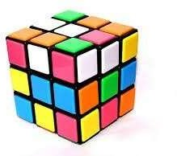
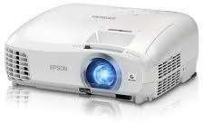

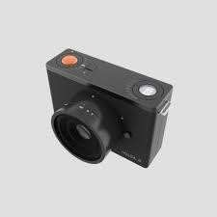
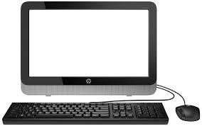


Physical / Logical Objects

Slide 18
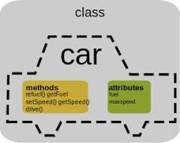
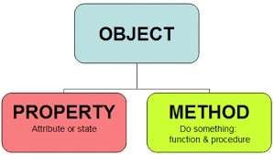
🞄 Object have properties(attributes) and behavior(Method).
🞄 For Example:
Attributes and Behavior

Slide 19
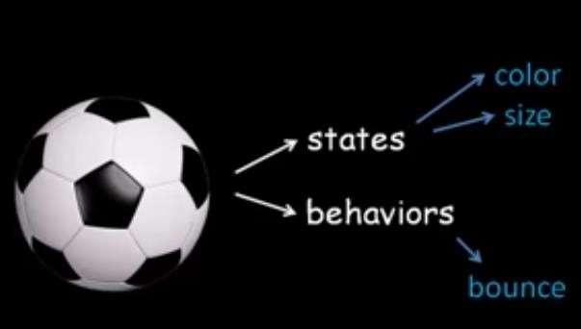
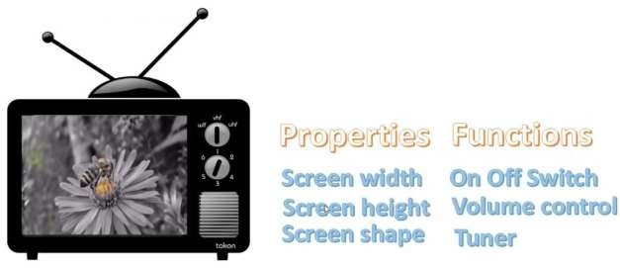
Examples

Slide 20
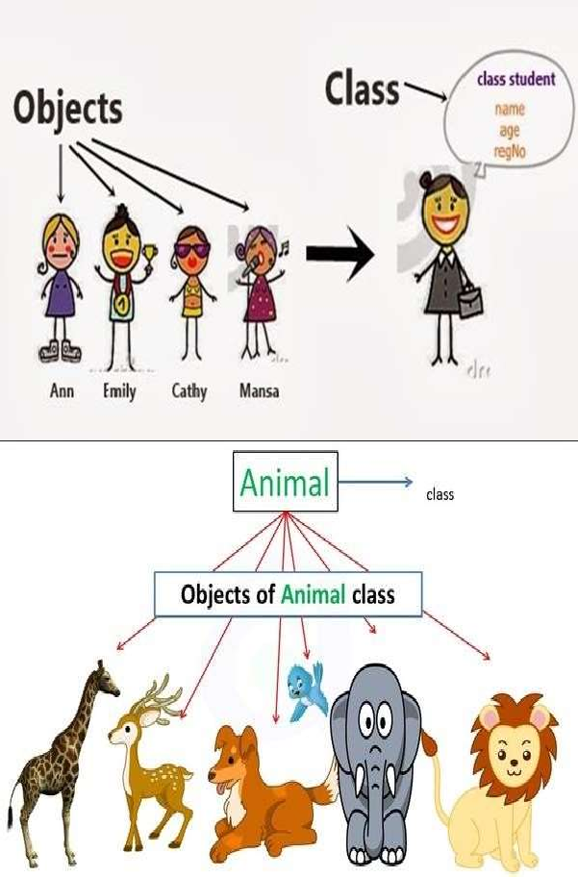
Examples

Slide 21
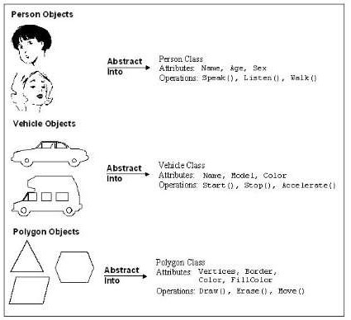
Examples

Slide 22

🞄 Abstraction means displaying only essential information and hiding the details. Data abstraction refers to providing only essential information about the data to the outside world, hiding the background details or implementation.
Abstraction

Slide 23
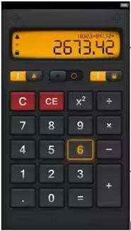
🞄 Example1
🞄 Consider a real life example of a man driving a car. The man only knows that pressing the accelerators will increase the speed of car or applying brakes will stop the car but he does not know about how on pressing accelerator the speed is actually increasing, he does not know about the inner mechanism of the car or the implementation of accelerator, brakes etc in the car. This is what abstraction is.
🞄 Example 2:
Examples
🞄 The calculator shown in the figure has to be powered by a battery source. How the battery module works for the calculator is not necessary to know for the user who uses calculator.

Slide 24
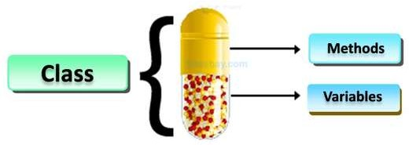
functions in a single unit called class.
🞄 Encapsulation is a process of combining data members and
🞄 As in encapsulation, the data in a class is hidden from other
classes, so it is also known as data-hiding.
Encapsulation

Slide 25
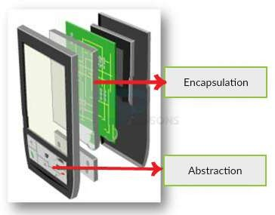
Abstraction and Encapsulation

Slide 26
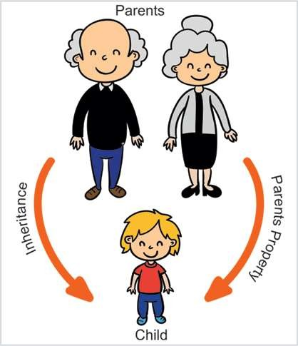
Inheritance
The capability of a class to derive properties and characteristics from another class is called Inheritance. Inheritance is one of the most important feature of Object Oriented Programming.
Child Class: The class that inherits properties from another class is called Sub class or Derived Class.
Parent Class: The class whose properties are inherited by sub class is called Base Class or Super class.

Slide 27
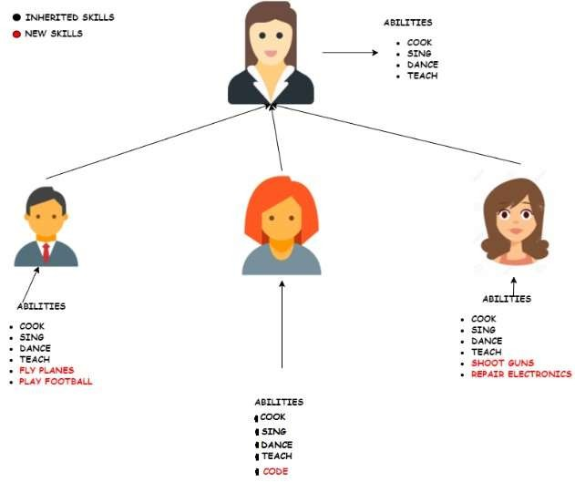
Example

Slide 28
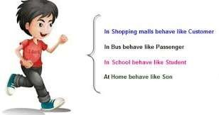
🞄 we can define polymorphism as the ability of a message to be
displayed in more than one form.
🞄 Real life example of polymorphism, a person at a same time can have different characteristic. Like a man at a same time is a father, a husband, a employee. So a same person posses have different behavior in different situations. This is called polymorphism.
Polymorphism

Slide 29
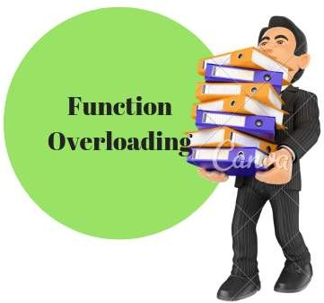
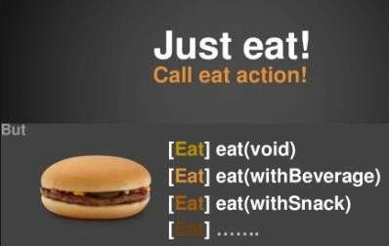
Example

Slide 30
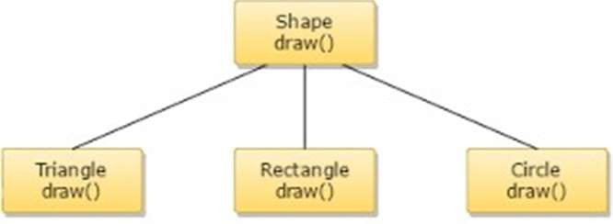
🞄 Dynamic binding (also known as late binding ) means that the code associated with a given procedure call is not known until the time of the call at run time.
🞄 It is associated with polymorphism and inheritance. A function call associated with a polymorphic reference depends on the dynamic type of that reference.
Dynamic Binding
Every Object will have draw( ) procedure, however this draw( ) will be redefined in each class.
At Run-time, the code matching the object under current reference will be called.

Slide 31
🞄 An object-oriented program consists of a set of objects that communicate with each other.
🞄 The process of programming in an object-oriented language:
Creating classes that define object and their behavior,
Creating objects from class definitions, and
Establishing communication among objects.
Message Passing
🞄 Objects communicate with one another by sending and receiving information much the same way as people pass messages to one another.
🞄 The concept of message passing makes it easier to talk about building systems that directly model or simulate their real world counterparts.

Slide 32
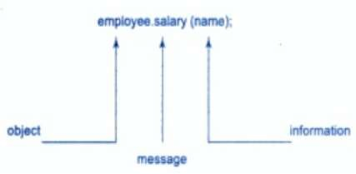
🞄 A Message for an object is a request for execution of a procedure, and therefore will invoke a function (procedure) in the receiving object that generates the desired results.
🞄 Message passing involves specifying the name of object, the
name of the function (message) and the information to be sent.
Message Passing

Slide 33
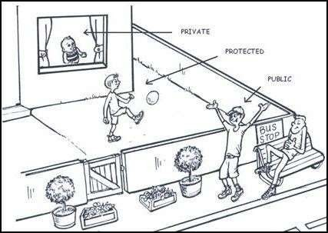
Object Oriented Programming known as Data Hiding.
🞄 Access modifiers are used to implement important feature of
🞄 Access modifiers or Access Specifiers in a class are used to set the
accessibility of the class members.
🞄 It sets some restrictions on the class members not to get directly
accessed by the outside functions.
Access Modifiers

Slide 34
🞄 There are 3 types of access modifiers available in C++:
🞄 Public:
🞄 A public member is accessible from anywhere outside the class but within a program.
🞄 Private:
🞄 A private member variable or function cannot be accessed, or even viewed from outside the class. Only the class and friend functions can access private members.
🞄 Protected:
🞄 A protected member variable or function is very similar to a private member but it provided one additional benefit that they can be accessed in child classes which are called derived classes.
Access Modifiers

Slide 35
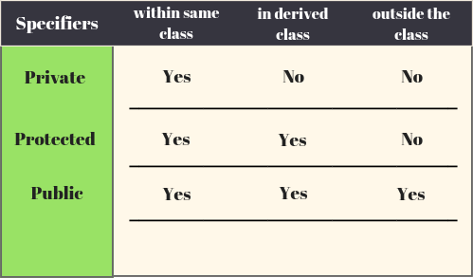
using namespace std;
#include <iostream>
class access
{
private:
int a_pri = 10;
protected:
int b_pro = 20;
public:
int c_public = 30;
};
Access Modifiers

Slide 36
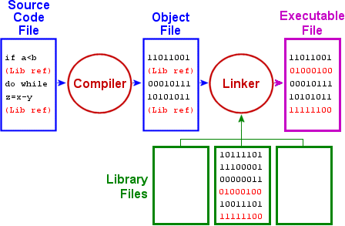
Typical C++ Environment

Slide 37
🞄 Phase 1: Creating a Program:
🞄 It consists of editing a file with an editor program C++ source code
filenames often end with the .cpp extensions.
🞄 Unix/Linux platform: use gedit, nano, medit etc. text editors
Windows: Notepad++, IDE such as turboC++, Codeblocks etc.
Typical C++ Environment
🞄 Phases 2 and 3: Preprocessing and Compiling a C++ Program
🞄 A preprocessor program executes automatically before the compiler’s translation phase begins. The C++ preprocessor obeys commands called preprocessor directives, which indicate that certain manipulations are to be performed on the program before compilation.

Slide 38
🞄 Unix/Linux: g++ filename.cpp –o filename
🞄 Compile Program and Run :
./filename
🞄 Windows: In Turbo c++ : ALT + F9 and CTL + F9
Code Block: F5 and F9
🞄 Phase 4: Linking
A linker links the object code with the code for the missing functions to produce an executable program.
Typical C++ Environment
🞄 Phase 5: Loading & Phase 6: Execution
The loader takes the executable program from disk and transfers it
to memory for execution.

Slide 39
C++ Program Structure
Header File Declaration Section | Header files used in the program , Prototype declaration for functions, user define header file, all preprocessor directives are written in this section.
Global Declaration Section | Global variables are declared here.
Class declaration And Method Definition Section | Class declaration and all methods of that class are defined here.
Main Function | Each and every C++ program always starts with main function. We can create class objects in the main.

Slide 40
C++ Program Structure
Include files
Class Declaration
Member Function Definition
Main function

Slide 41
🞄 Header files contain definitions of Functions and Variables, which is imported or used into any C++ program by using the pre- processor #include statement.
🞄 Header file have an extension “.h”
Header Files
🞄 Types of Header files
🞄 System header files: It comes with compiler.
🞄 User header files: It is written by programmer.

Slide 42
🞄 Preprocessor directive
🞄 C++ program line beginning with # that provides an instruction to the preprocessor
🞄 Preprocessor
🞄 A system program that modifies a C++ program prior to its
compilation
🞄 Library
🞄 A collection of useful functions and symbols that may be accessed
by a program
🞄 #include Directive:
🞄 Two forms:
#include <filename>
Preprocessor Directives
🞄 #include <filename>
🞄 For standard library header files
🞄 #include "filename"
🞄 Normally used for programmer-defined files
#include<iostream>
#include "filename" #include “abc.h”

Slide 43
🞄 Symbolic constants
🞄 #define
🞄 Constants represented as symbols
Preprocessor Directives
🞄 When program compiled, all occurrences replaced
🞄 Format
🞄 #define identifier replacement-text
🞄 #define PI 3.14159

Slide 44
🞄 This defines a scope for the identifiers that are used in a program.
🞄 For using the identifiers defined in the namespace scope we must
include the using directive, like
using namespace std;
🞄 Here, std is the namespace where ANSI C++ standard class libraries are defined.
🞄 All ANSI C++ programs must include this directive. This will bring all the identifiers defined in std to the current global scope.
🞄 using and namespace are the new keywords of C++.
🞄 To call the namespace-enabled version of either function or
variable, prepend the namespace name as follows:
🞄 name :: code; // code could be variable or function
Namespace

Slide 45
🞄 cout, cin and a lot of other things are defined in it. you can also access them using std::cout , std::cin etc.
Without namespace | With namespace
#include <iostream> int main() { std::cout<< “Hello ”; } | #include <iostream> using namespace std; int main() { cout<< “Hello ”; }
Namespace

Slide 46
🞄 You can also avoid prepending of namespaces with the using namespace directive. This directive tells the compiler that the subsequent code is making use of names in the specified namespace.
🞄 Defining a namespace:
namespace name_of_namespace
{
// code
}
Using directive

Slide 47
int main()
{
int value;
value = 0;
double value; //Error
value=0.0;
}
So, there cannot be two variables with the same name in the same scope.
Namespace Example
Using namespaces, we can create two variables or member functions having the same name.

Slide 48
#include <iostream>
using namespace std;
namespace first
{
int val=500;
}
int main()
{
// Local variable;
int val = 200;
cout<<first::val<<“\n”<<val; return 0;
}
These variables can be accessed from outside the namespace using the scope resolution operator ::
Namespace Example
Output:
500
200

Slide 49
Namespace Example
#include <iostream> int main() { char str [16]; std::cout << “Enter a string:”; std::cin >>str; std::cout << “You entered: ”<<str; return 0; } | #include <iostream> using namespace std; int main() { char str [16]; cout << “Enter a string:”; cin >>str; cout << “You entered: ”<<str; return 0; }

Slide 50
Thank you

